Slide 1
Dropout in Neural Networks
Dropout layers have been the go-to method to reduce the overfitting of neural networks. It is the underworld king of regularization in the modern era of deep learning.

Slide 2
INTRODUCTION
The deep neural networks have different architectures, sometimes shallow, sometimes very deep trying to generalize on the given dataset. But, in this pursuit of trying too hard to learn different features from the dataset, they sometimes learn the statistical noise in the dataset.
This improves the model performance on the training dataset but fails massively on new data points (test dataset). This is the problem of overfitting.
To tackle this problem, we have various regularization techniques that penalize the weights of the network but this wasn’t enough.
The best way to reduce overfitting or the best way to regularize a fixed-size model is to get the average predictions from all possible settings of the parameters and aggregate the final output. But this becomes too computationally expensive and isn’t feasible for a real-time inference/prediction.
The other way is inspired by the ensemble techniques (such as AdaBoost, XGBoost, and Random Forest) where we use multiple neural networks of different architectures. But this requires multiple models to be trained and stored, which over time becomes a huge challenge as the networks grow deeper.
So, we have a great solution known as Dropout Layers.

Slide 3
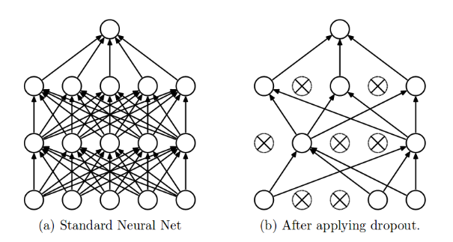
What is a Dropout?
The term “dropout” refers to dropping out the nodes (input and hidden layer) in a neural network (as seen in Figure 1). All the forward and backwards connections with a dropped node are temporarily removed, thus creating a new network architecture out of the parent network. The nodes are dropped by a dropout probability of p.
Let’s try to understand with a given input x: {1, 2, 3, 4, 5} to the fully connected layer. We have a dropout layer with probability p = 0.2 (or keep probability = 0.8). During the forward propagation (training) from the input x, 20% of the nodes would be dropped, i.e. the x could become {1, 0, 3, 4, 5} or {1, 2, 0, 4, 5} and so on. Similarly, it applied to the hidden layers.
For instance, if the hidden layers have 1000 neurons (nodes) and a dropout is applied with drop probability = 0.5, then 500 neurons would be randomly dropped in every iteration (batch).
Generally, for the input layers, the keep probability, i.e., 1- drop probability, is closer to 1, 0.8 being the best as suggested by the authors. For the hidden layers, the greater the drop probability sparser the model, where 0.5 is the most optimized keep probability, that states dropping 50% of the nodes.

Slide 4
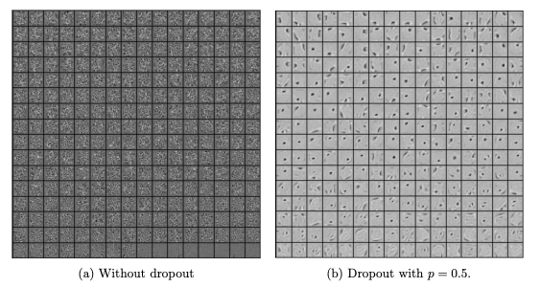
How does it solve the Overfitting problem?
In the overfitting problem, the model learns the statistical noise. To be precise, the main motive of training is to decrease the loss function, given all the units (neurons). So in overfitting, a unit may change in a way that fixes up the mistakes of the other units. This leads to complex co-adaptations, which in turn leads to the overfitting problem because this complex co-adaptation fails to generalize on the unseen dataset.
Now, if we use dropout, it prevents these units to fix up the mistake of other units, thus preventing co-adaptation, as in every iteration the presence of a unit is highly unreliable. So by randomly dropping a few units (nodes), it forces the layers to take more or less responsibility for the input by taking a probabilistic approach.
This ensures that the model is getting generalized and hence reducing the overfitting problem.

Slide 5

Dropout Implementation
n the original implementation of the dropout layer, during training, a unit (node/neuron) in a layer is selected with a keep probability (1-drop probability). This creates a thinner architecture in the given training batch, and every time this architecture is different.
In the standard neural network, during the forward propagation we have the following equations:
where:
z: denote the vector of output from layer (l + 1) before activation
y: denote the vector of outputs from layer l
w: weight of the layer l
b: bias of the layer l
Further, with the activation function, z is transformed into the output for layer (l+1).

Slide 6
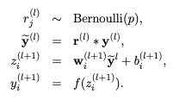
Now, if we have a dropout, the forward propagation equations change in the following way:
So before we calculate z, the input to the layer is sampled and multiplied element-wise with the independent Bernoulli variables. r denotes the Bernoulli random variables each of which has a probability p of being 1. Basically, r acts as a mask to the input variable, which ensures only a few units are kept according to the keep probability of a dropout. This ensures that we have thinned outputs “y(bar)”, which is given as an input to the layer during feed-forward propagation.

Slide 7
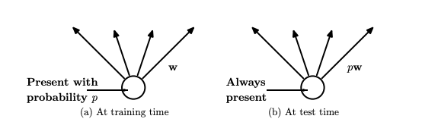
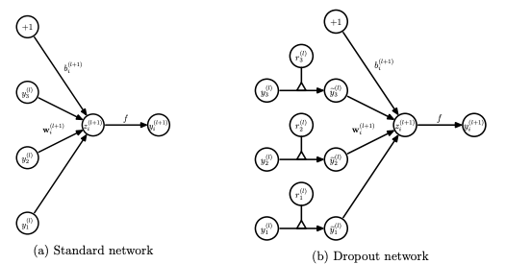
Figure 3: (a) A unit (neuron) during training is present with a probability p and is connected to the next layer with weights ‘w’ ; (b) A unit during inference/prediction is always present and is connected to the next layer with weights, ‘pw’ (Image by Nitish)

Slide 8
CONCLUSION
Dropouts can be used with most types of neural networks. It is a great tool to reduce overfitting in a model. It is far better than the available regularisation methods and can also be combined with max-norm normalisation which provides a significant boost over just using dropout.

